Slide 1

Fraud Detection
Power BI Desktop
Overview
# Transaction
# Transaction - Fraud
% Fraud Rate
$ Fraud Amount
118.108K
4.064K
3.44%
609.93K
% Actual Fraud Rate
by AmountBand
% Actual Fraud Rate
by ProductCD
% Actual Fraud Rate
by card6 and card4
% Actual Fraud Rate
by DeviceType
8%
7.34%
6.38%
C
13.35%
(Blank) 1.98%
6%
20%
4.08%
H
5.91%
5.28%
4%
3.72%
3.11%
2.85%
2.79%
S
5.23%
9.43%
2%
10%
desktop 8.00%
R
4.68%
2.59%
0%
W
1.93%
2.42%
5. 500 to
under 1000
1. Under
50
4. 200 to
under 500
6. 1000 2. 50 to
and under
above 100
3. 100 to
under 200
2.91%
3.70%
2.02%
mobile 11.43%
0%
5%
10%
15%
0%
credit
debit
(Blank)
% Actual Fraud Rate
by TranHour
15%
13.50%
10%
9.40%
9.87%
6.48%
7.07%
5%
3.97%
4.86%
4.41%
3.75%
3.15%
3.43%
3.61%
3.39%
3.54%
3.49%
2.86%
2.70%
2.69%
2.74%
1.95%
2.33%
2.68%
3.35%
2.92%
0%
0
5
10
15
20

Slide 2
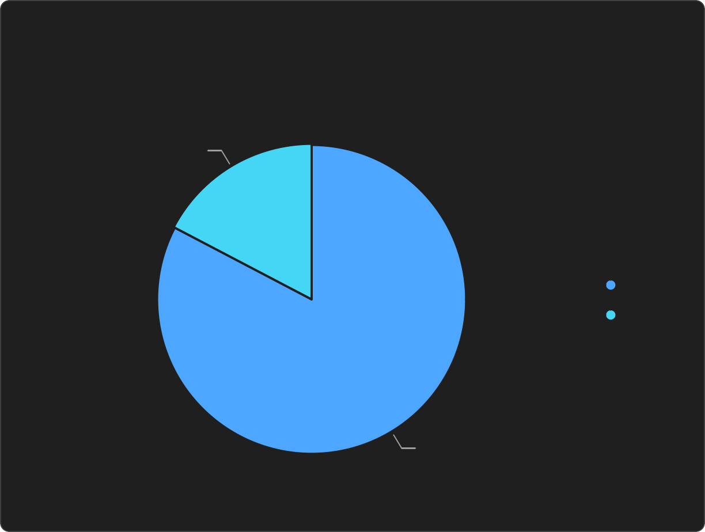

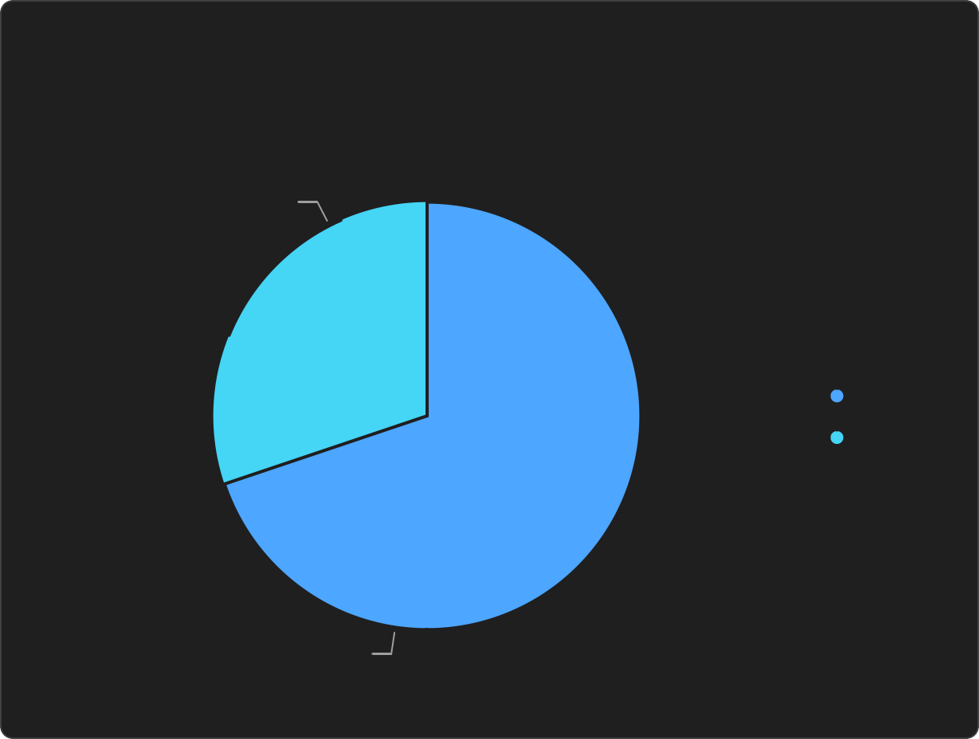
Fraud Detection
Power BI Desktop
Missing Data & Fraud Rate
% Missing Identity Info.
% Avail Identity - Fraud
% Missing Identity - Fraud
79.88%
10.30%
1.96%
Email Domain
Address
Distance
P-Email Domain | R-Email Domain
Address 1
Address 2
Distance 1
Distance 2
% Actual Fraud Rate
by R-Email Domain
% Actual Fraud Rate
by Address 1
% Actual Fraud Rate
by Distance 1
(Blank) 1.96% (17.32%)
Available 2.31% (14.6%)
Available 1.99% (30.16%)
Avilable (Blank)
(Blank) Available
(Blank) Available
Avilable 9.35% (82.68%)
(Blank) 13.50% (85.4%)
(Blank) 4.62% (69.84%)

Slide 3
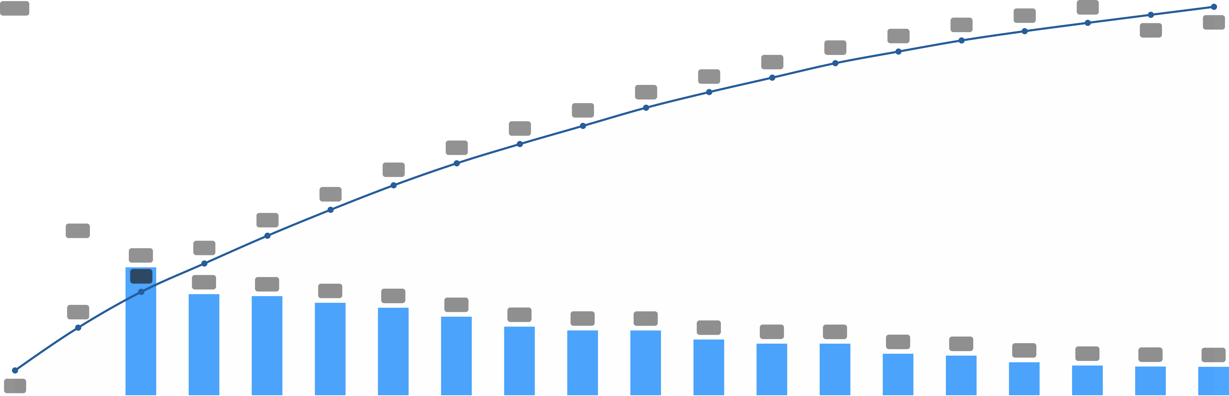
Fraud Detection
Power BI Desktop
Important Feature
# Features
% Top 20 Cum. Importance
433
58.43
% Importance and % Cumulative
by Feature(Column)
14
13.1
56
60
54
55
57
58
12
51
53
48
50
50
10
46
44
41
39
40
8
36
33
6
5.3
30
30
4.5
23
26
4
3.5
3.5
3.2
3.1
18
2.7
2.4
2.3
2.3
20
2
1.9
1.8
1.8
1.5
1.4
1.2
1.0
1.0
1.0
0
13
10
V258
C1
DeviceInfo
C14
V294
C13
card2
card1
D2
P_emaildomain
id_31
addr1
D15
C11
TranHour
card6
C8
C7
R_emaildomain
TransactionAmt
% Importance
% Cumulative

Slide 4
Fraud Detection
Power BI Desktop
Model Performance | LightGBM
% Predicted Fraud
% Recall - Threshold 0.2
% Precision - Threshold 0.2
% F1-Socre - Threshold 0.2
2.90%
50.1476%
59.5210%
54.434%
# TransactionID
by AlertType
Threshold
% Precision
% Recall
% F1_Score
# True_Positive
# True_Negative
# False_Positive
# False_Negative
0.10 43.8679% 61.7864% 51.308%
2511
110831
3213
1553
2038
0.20 59.5210% 50.1476% 54.434%
2038
112658
1386
2026
2,000
2026
0.30 69.8705% 43.8238% 53.864%
1781
113276
768
2283
0.40 76.9529% 39.0256% 51.788%
1586
113569
475
2478
0.50 82.0408% 34.6211% 48.694%
1407
113736
308
2657
1,500
1386
1,000
Model
%Average_Precision

% ROC_AUC
LightGBM Tuned
0.5717
0.9181
LightGBM
0.5615
0.9117
500
CatBoost
0.5562
0.9007
Logistic Regression
0.1840
0.8338
Dummy Baseline
0.0344
0.5000
0
True Positive
False Negative
False Positive

